Slide 1
ECE 5397/6397:
Introduction to Robotics
Welcome & Lecture 1
Reference: Chapter 1, RD&C
Instructor: Aaron Becker
youtube.com/aabecker5/
www.SwarmControl.net

Slide 2
Welcome!
Fundamentals of robotics: the Mathematical modeling of robots as mechanical devices
Definitions:
Robot: from Czech word for work “robota”: A robot is a reprogrammable, multifunctional manipulator designed to move material, parts, tools, or specialized device through variable programmed motions for the performance of a variety of tasks
Robots come from teleoperators + numerically controlled milling machines
ROS install night: Tuesday, Jan 26, 7pm, N386
Notes:
Teleoperators from WWII to handle radioactive materials
CNC developed because of high precision required to machine certain items

Slide 3
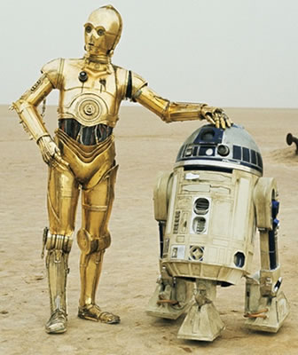
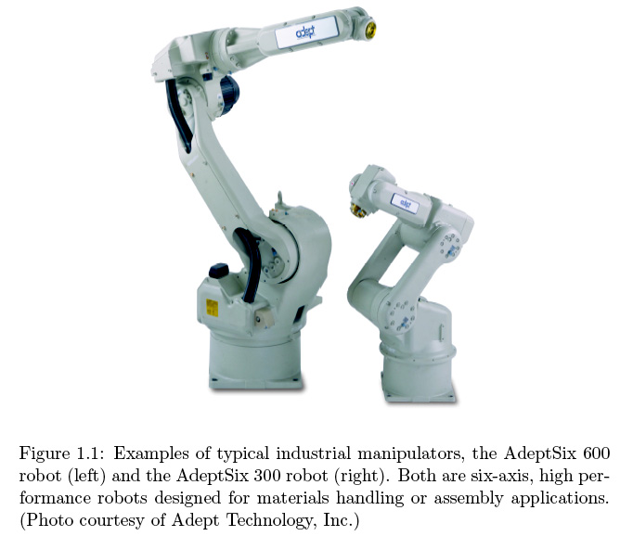
“Robot”
Notes:
A robot is a reprogrammable, multifunctional manipulator designed to move material, parts, tools, or specialized devics through variable programmed motions for the performance of a variety of tasks

Slide 4
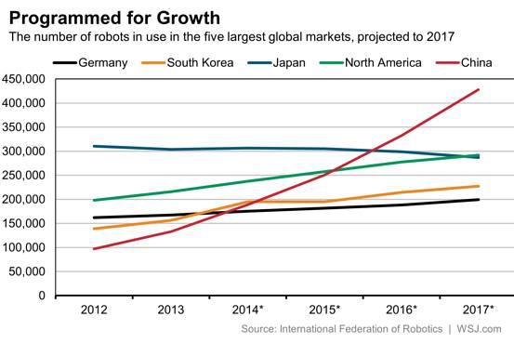
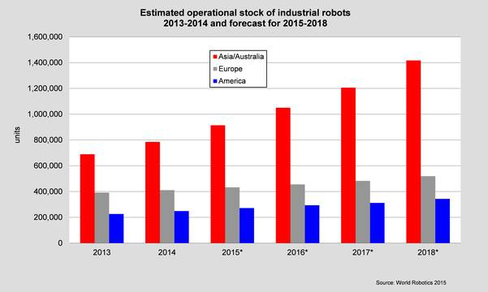
Worldwide robots
plot
Notes:
http://www.ifr.org/industrial-robots/statistics/

Slide 5
Important
This course will use a lot of mathematics
This material can only be learned from solving practice problems every day
Every class will have an in-class activity
Come prepared to each class
Do not fall behind
Immediate Action Items for you:
Brush up on your Math, especially Trigonometry (really), and Linear Algebra (appendix A and B)
Sign up for swarmathon & github https://github.com/UH-ECE6397
Download A Gentle Introduction to ROS

Slide 6
Software
We will use MATLAB for some of our assignments and examples
You learned to use in ECE 1331
You have a month to brush up your MATLAB skills
Get latest MATLAB version on your computer
Free campus-wide license
Each 3-person team needs access to a computer with ROS, and each member needs time on it
Swarmathon uses C++, ROS has wrappers for any language

Slide 7
Optional Software
I like to use Mathematica for playing around with robots http://demonstrations.wolfram.com/author.html?author=Aaron+Becker
Fun and informative
Great for verifying solutions to problems
You are welcome to try it, but it is not required
Free download for all UH students and faculty
A published, intro-to-robotics-Mathematica demonstration (with Dr. Becker as the last author), will add 2.5 to 6% to your final grade. Some topics include  demonstration on inverse velocity kinematics as robot traces out a square and circle,  calculation and plot of manipulability ellipse of robot arm at different configurations,  demonstration on DH parameters,  visualization of robot workspace  configuration vs. workspace of an RR robot  visualization of workspace singularities.

Slide 8
Instructor
Instructor: Aaron Becker
Email (best): atbecker@uh.edu
Phone: 713-74306671
Office: Room N338, Engineering Building 1
Office hours: Tues & Thursdays 2-3:30pm
TA: Li Huang
Email: : lihuang.mech@gmail.com
Phone: (713) 743-7296
Office hours: 2:00-3:30pm, Mon & Wed

Slide 9
How Grades are Assigned
Item | Schedule | Points | Adjustment
Worksheet (in class) | One per lecture | 10% | Lowest score dropped
Homeworks | One per chapter | 30% | Lowest score dropped
Lab /ROS | distributed | 20%
Mid-term 2 (Ch 3 – 4) | April 4th | 20%
Final Exam (Ch 1 – 6) | Finals Week (Date TBD) | 20%
Relative Grading
All students are ranked based on overall grade
Letter grades based on your rank in class
Generous reward for effort
Attempt everything & do your best
I’m looking for 1-2 new grad students
Be honest and stay out of trouble
Simply not worth it!

Slide 10
Course Policies
This course is about learning fundamental concepts
Do the problems by hand first, and use calculators/software to verify
For the exams, calculators/computers/tablets are not allowed
Please read the handout carefully
Ask questions, get answers
Give feedback – help me teach you better

Slide 11
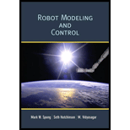
Required Textbook
We will follow the book closely
Chapters 1, 2, 3, 4, 5, 11, 12.
Bring it to each class – we will use it
Helpful handouts will be provided when needed
Recommended Books:
ROS textbook: A Gentle Introduction to ROS. Free at https://cse.sc.edu/~jokane/agitr/. Print version at $12.50 at
Cost: $95

Slide 12


Assemble your teams by Jan 28
Swarmathon: 3 to 4-person teams. Each team completes 3 challenges in ROS, concluding with in-class competition on Swarmathon challenge.
Robot Arm: 2-person teams.
http://marvel-movies.wikia.com/wiki/The_Avengers_(team)
Toyrus.com
Notes:
Pick a diverse team (a programmer, a mechanical person, a math person)

Slide 13
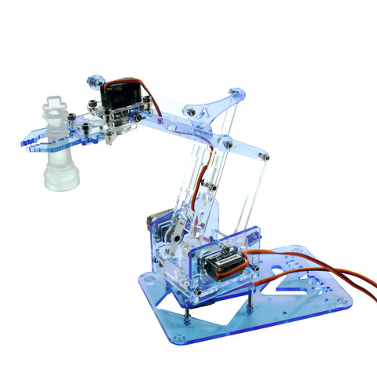
Two Projects
Swarmathon details: webinar Jan. 22
http://nasaswarmathon.com/
D N328 reserved – you can watch from anywhere
Robot arm: purchase motors and Arduino as soon as you have a team
http://www.instructables.com/id/MeArm-Robot-Arm-Your-Robot-V10/

Slide 14
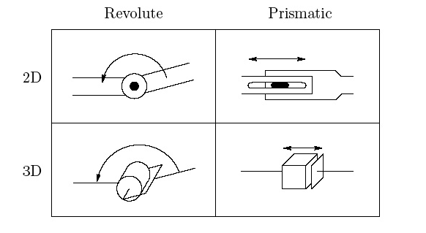
Mathematical Modeling of Robots
Robot manipulator is composed of links connected by joints to form a kinematic chain
Revolute joint (hinge), R
Prismatic joint (slide), P

Slide 15
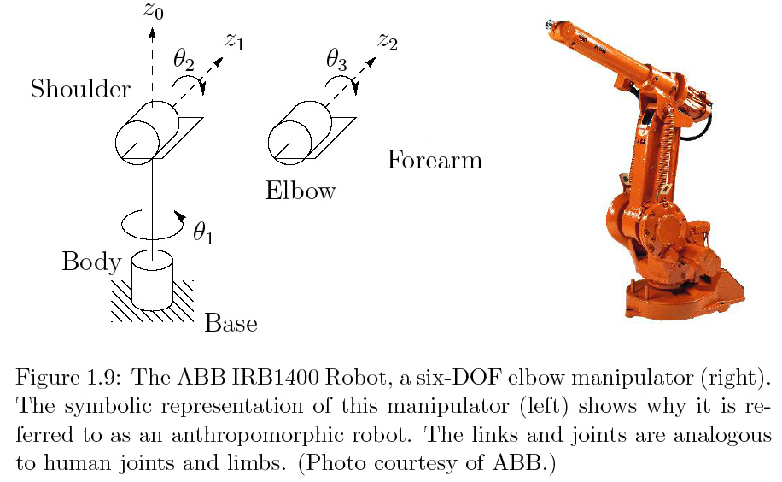
Symbolic Representation
i^{th} joint connects link i and i+1
z_{i} is axis of rotation of revolute, axis of translation of prismatic
Joint variables θ_{i} revolute, d_{i} prismatic
What type of Robot is this?
How do we describe the configuration?
RRR
θ₁ θ₂ θ₃

Slide 16

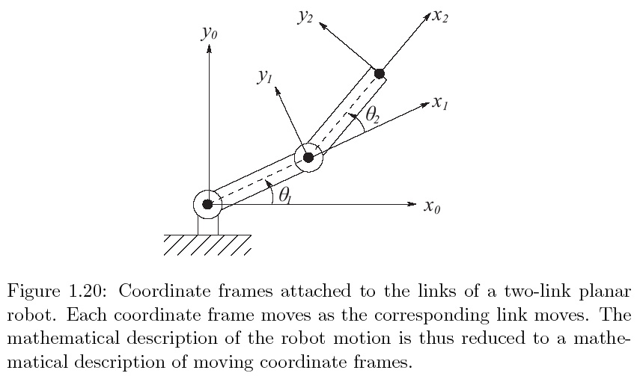
Configuration Space
Configuration of a manipulator: complete specification of the location of every point on the manipulator
Configuration space: set of all configurations
Denote with vector q = [q_{1,} q₁,…, q_{n}]
Degrees of freedom (DOF) number of parameters to minimally specify configuration
Configuration space
q = θ₁ θ₂
Notes:
----- Meeting Notes (1/19/16 12:51) -----
add q2 aqn

Slide 17
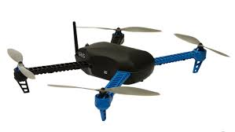
Configuration Space
An object in space has 6 DOF:
3 positioning (x,y,z)
3 orientation (θ,ϕ,ψ)
Manipulator usually has 6 DOF
Manipulator with more than 6 DOF is kinematically redundant
Notes:
Get a volunteer: is their arm kinematically redundant
kinematically redundant
Useful for reaching around or behind obstacles

Slide 18
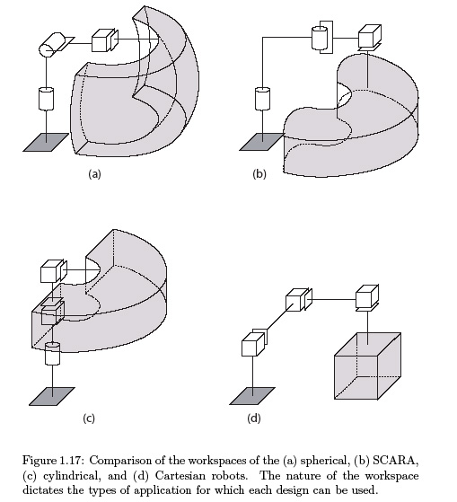
Tricky: State Space / Workspace
Configuration describes geometry, not dynamics
State of manipulator: set of variables that with description of manipulator dynamics and future inputs, determines the future time response of the manipulator
State space: set of all possible states
For robot manipulator, state is joint variables q and joint velocities
Workspace is total volume swept out by the end effector as manipulator executes all possible motions
Reachable workspace: set of points reachable
Dextrous workspace: set of points where all orientations are possible
workspace
Statenspace: [θ₁, θ₂, d₃, ^{d}/_{dt}θ₁, ^{d}/_{dt}θ₂, ^{d}/_{dt}d₃]
Notes:
Workspace often constrained

Slide 19
Classifying Robot Manipulators
Power: electric/hydraulic/pneumatic
Method of control: servo/nonservo
Application area: assembly/nonassembly
Geometry: RRR, RRP, etc, serial vs. parallel
Fun: http://new.abb.com/products/robotics/robot-selector
Notes:
Fun video: http://search-ext.abb.com/library/Download.aspx?DocumentID=9AKK106713A0297&LanguageCode=en&DocumentPartId=&Action=Launch

Slide 20
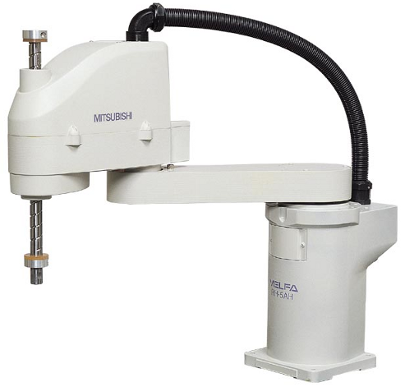
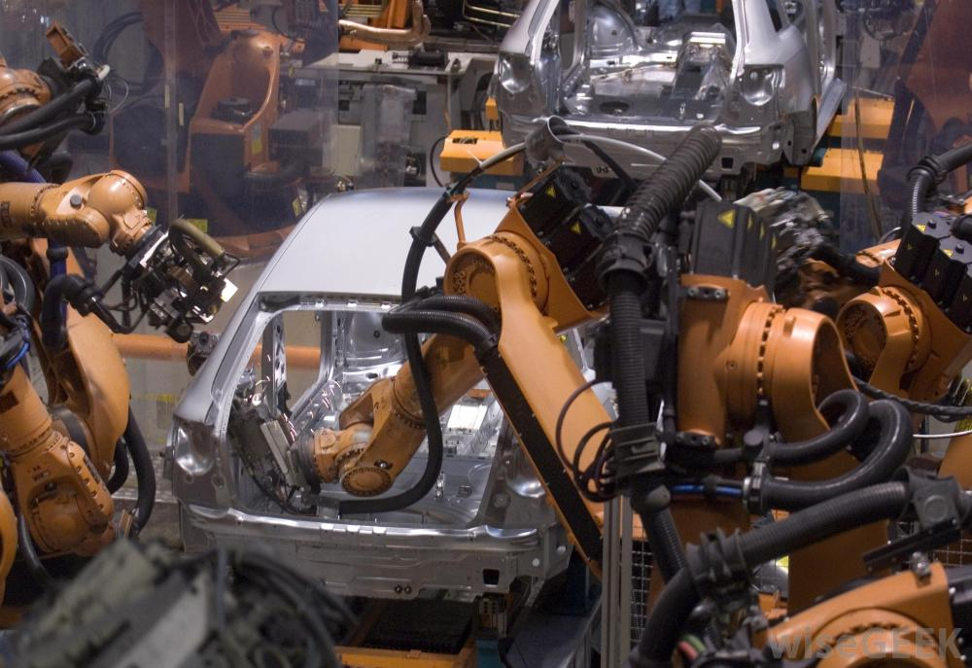
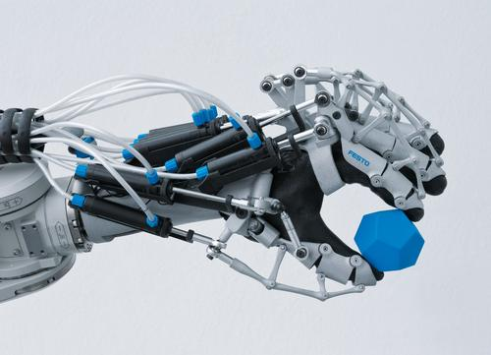
Classifying Robot Manipulators
Power: electric/hydraulic/pneumatic
Mitsubishi electric, wisegeek.com, festo.com
Electric: cheaper, cleaner, quieter
Hydraulic: stronger
Pneumatic: often inexpensive/simple, precise control hard (but see Festo)

Slide 21
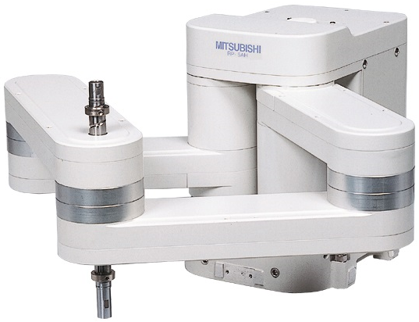
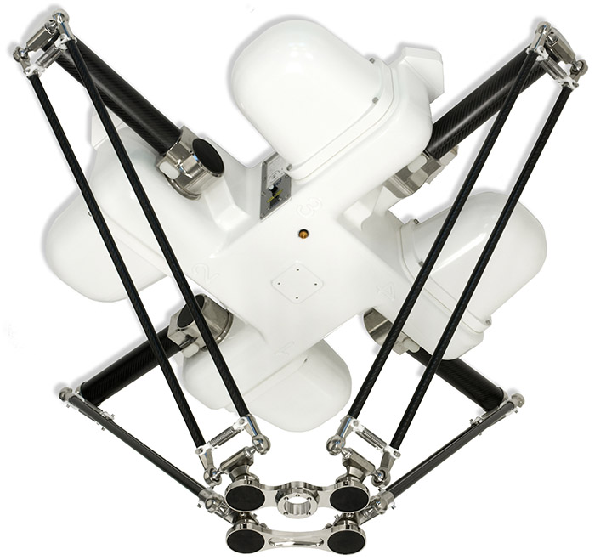
Classifying Robot Manipulators
Method of control: servo/nonservo
Nonservo: open-loop
Servo (closed loop)
Point-to-point: can specify desired position of end-effector
Continuous path: follows trajectories
Geometry: serial vs parallel
Serial and parallel robots from Mitsubishi
The 4-DOF Quattro robot by Adept Technology.
Notes:
Fun video: http://search-ext.abb.com/library/Download.aspx?DocumentID=9AKK106713A0297&LanguageCode=en&DocumentPartId=&Action=Launch

Slide 22
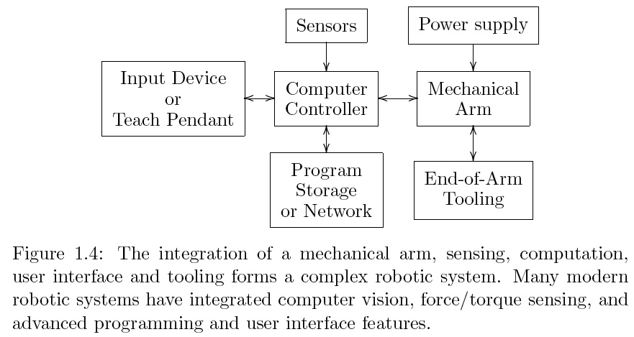
Robot System
Notes:
Manipulator more than just series of mechanical linkages. The mechanical arm is just a component in the robotic system

Slide 23
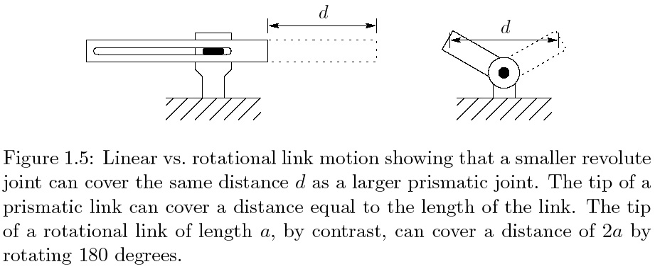
Why Rotational Links?
Rotational links have lower resolution, kinematic coupling between links, and harder math.

Slide 24
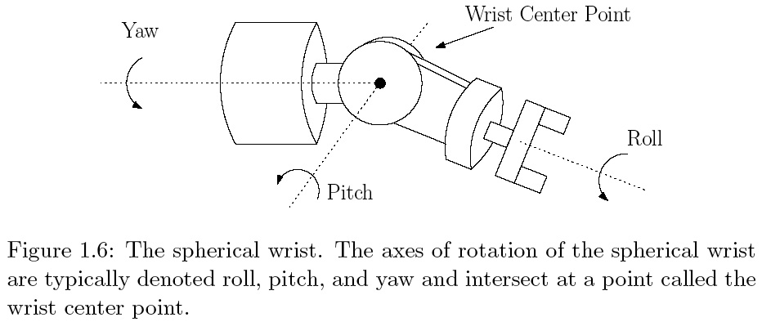
Wrists
Sphereical wrist: greatly simplifies kinematic analysis: decouples position and orientation of end effector

Slide 25
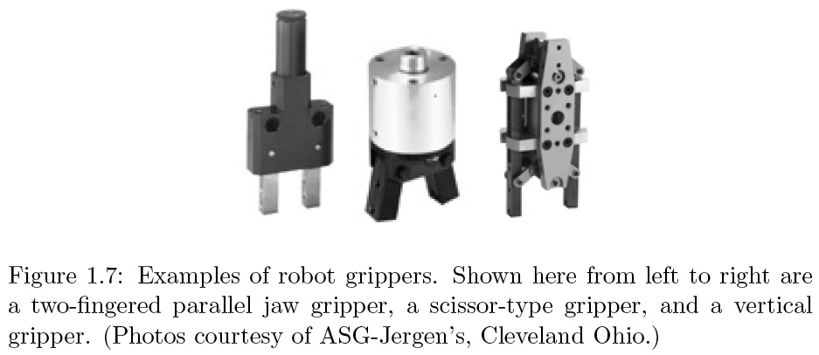
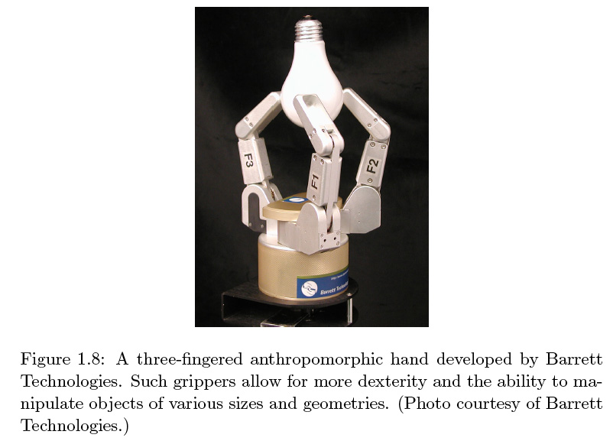
End effector/ Hand

Slide 26
Common Kinematic Arrangements
Time to Stand up and act them out!
Really – stand up!

Slide 27
Articulated Manipulator: RRR
Articulated Manipulator, AKA revolute, elbow, anthropomorphic

Slide 28
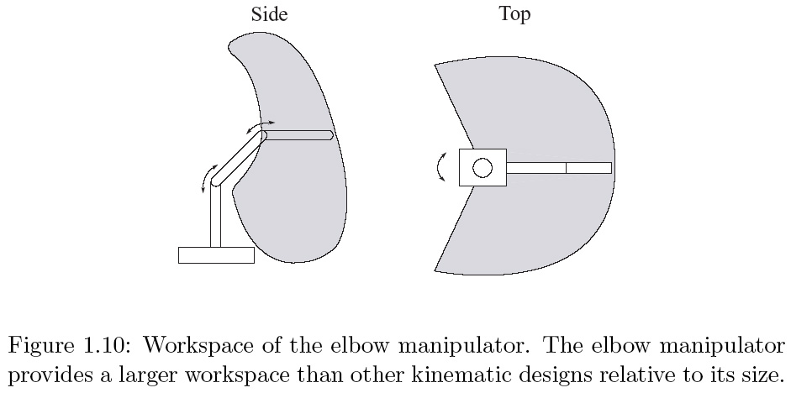
Articulated Manipulator: RRR
Articulated Manipulator, AKA revolute, elbow, anthropomorphic

Slide 29
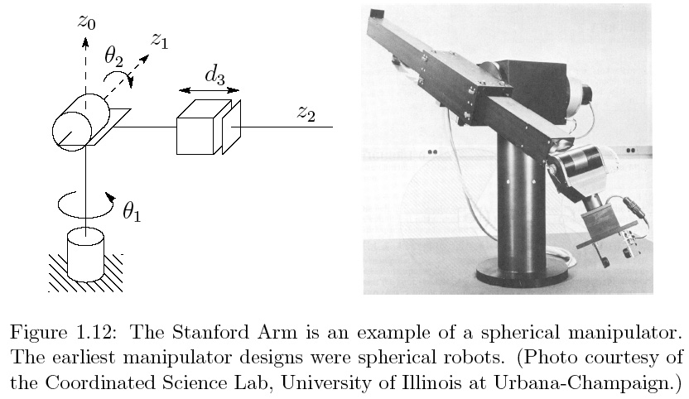
Spherical Manipulator: RRP
One of the first manipulator designs

Slide 30
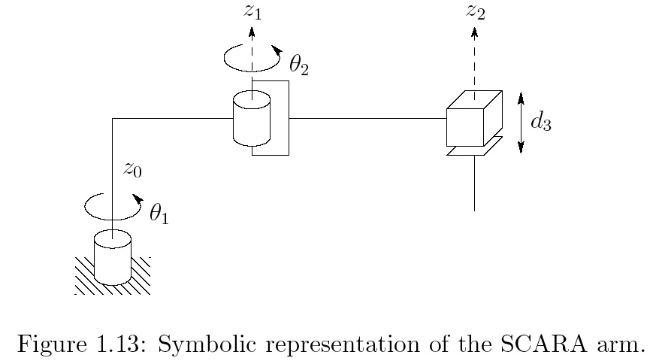
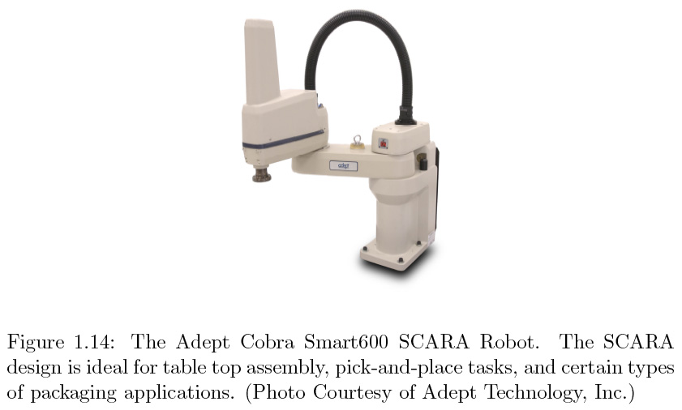
SCARA: RRP
Selective Compliant Articulated Robot for Assembly

Slide 31
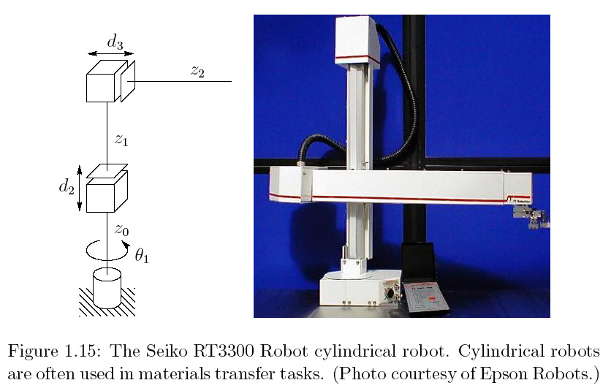
Cylindrical: RPP

Slide 32
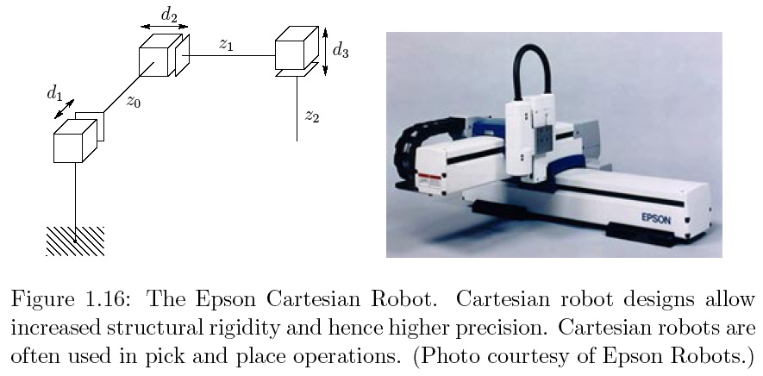
Cartesian: PPP

Slide 34
Activity: problem 1, handout
Power: electric/hydraulic/pneumatic
Method of control: servo/nonservo
Application area: assembly/nonassembly
Geometry: RRR, RRP, etc., serial vs. parallel
arc welding packing
grinding,
parts inspection,
small parts assembly,
cleaning/spraying,
spot welding,
painting

Slide 35
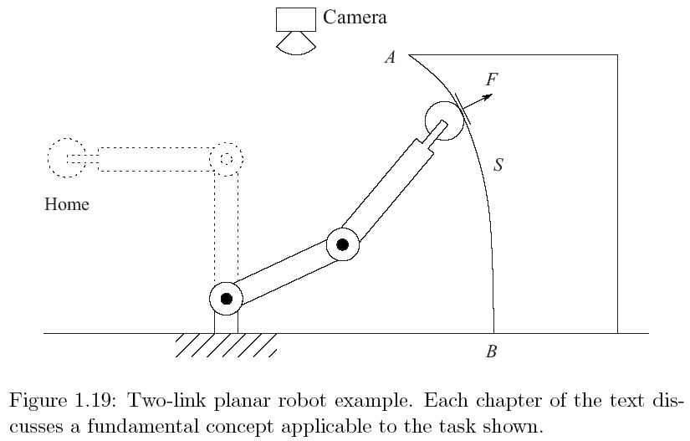
Outline Of Class
want manipulator to move from home to A to follow surface contour to B at constant velocity while maintaining force F.
Notes:
Typical Application: an industrial manipulator. This one has a metal grinding wheel, job is to remove a certain amount of material from a surface. “What are basic issues? What do we need to learn?”

Slide 36
Coordinate System Ch. 2
Describe position of tool, A, B in common coordinate system (Ch. 2: coordinate sys. and transformations)
Typically robot has sensors to measure θ_{1,} θ_{2,} Forward Kinematics: determine position and orientation of end effector or tool in terms of joint variables

Slide 37
Forward Kinematics Ch. 3.2
a₂
a₁
Notes:
Do this on the board

Slide 38
Forward Kinematics ch 3.2
Location of end effector
a₂
a₁
Orientation of tool frame found by projecting coordinate frame 2 onto 0:
Rotation matrix:
Orientation of coordinate frame 2 according to coordinate frame 0
Notes:
Do this on the board
We will use homogenous coordintes and homogenous transformations to simplify

Slide 39
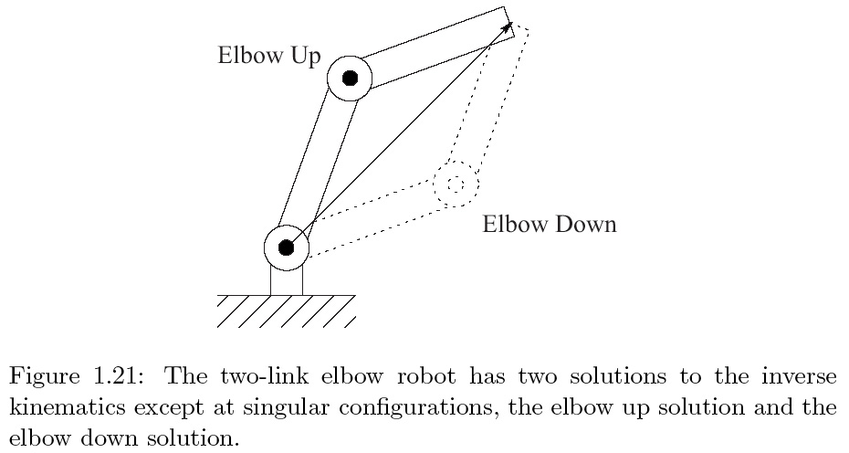
Inverse Kinematics Ch 3.3
To command the robot to move to A we need to determine θ_{1,} θ_{2.} [nonlinear equations to invert]
Notes:
Elbow up/ elbox down

Slide 40
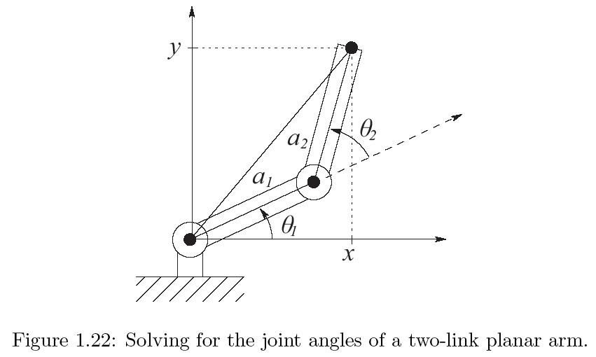
Inverse Kinematics Ch 3.3

Slide 41
Inverse Kinematics Ch 3.3
Law of cosines: triangle sides a,b,c, and angle opposite c is θ_{c,}
Rotation matrix

Slide 42
Velocity Kinematics Ch 4
Differentiate kinematic equations:
J = Matrix Jacobian

Slide 43
Inv. Velocity Kinematics Ch. 4
Notes:
Determinate By addition identity

Slide 44
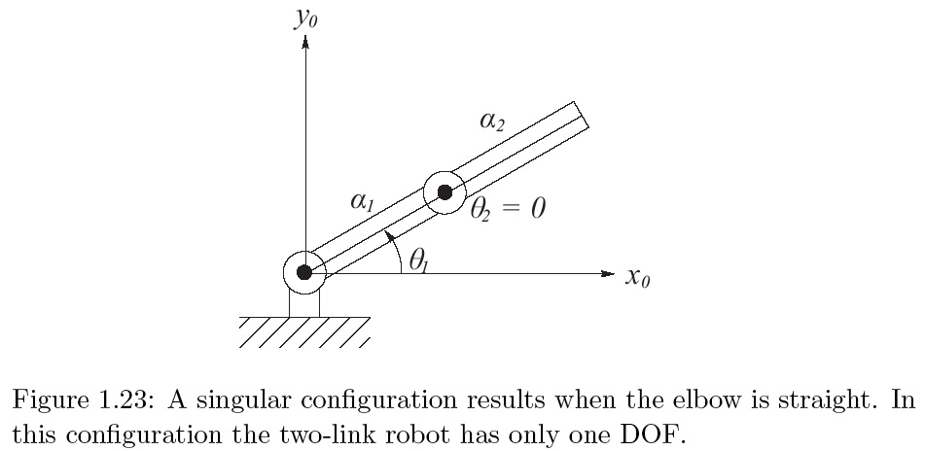
Singular Configurations Ch. 4

Slide 45
Summary
This course is about robot manipulators & ROS
We looked at a basic 2-link system:

Slide 46
For the Next Class
Work through the textbook examples in Chapter 1
Study Sections 2.1, 2.2 for Lecture 2
This is important: I want you to come prepared for each class by reading ahead, and have an idea of what to expect
Write down your questions and bring them with you
I may do a quiz in class based on your assigned reading
This is good for you
Advance reading will help you grasp the subject with much less effort

Slide 47
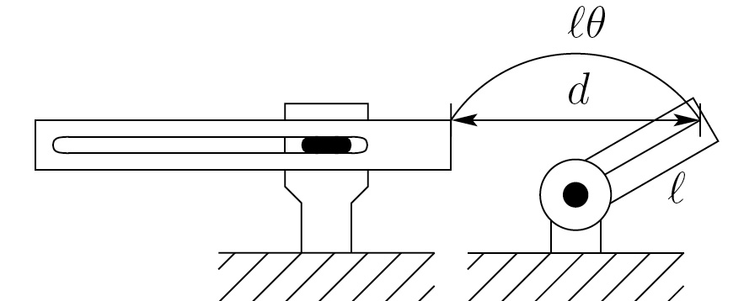
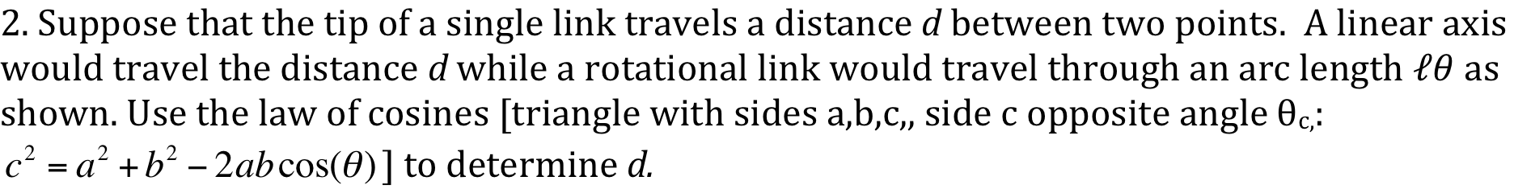
In class worksheet
3. Grad students: suppose we could close every factory today and reopen them tomorrow fully automated with robots. What would be some of the economic and social consequences of such a development?
Undergrads: Suppose a law were passed banning all future use of industrial robots. What would be some of the economic and social consequences of such an act?

